Slide 1
Computer Security Cryptography (2/3)
by Akkradach W.
Dept. of Computer Engineering
KMITL

Slide 2
Triple Data Encryption Algorithm
3DES / Triple DES / Triple DEA / TDEA
c = E(D(E(p,k₁),k₂),k₃)
p = D(E(D(c,k₃),k₂),k₁)
If k₁ ≠ k₂ ≠ k₃ then it’s 168-bits.
If k₁ ≠ k₂ but k₁ = k₃ then it’s 112-bits.

Slide 3
Advanced Encryption Standard
1977 – DES
1998 – 3DES
2001 – AES
By NIST, not NSA (?)
Derived from Square Cipher (1997)
Final round (Speed/Space vs Strength)
MARS, RC6, Twofish, Serpent, and Rijndael
Vincent Rijmen and Joan Daemen from BE
p{128}:k{128|192|256}

Slide 4
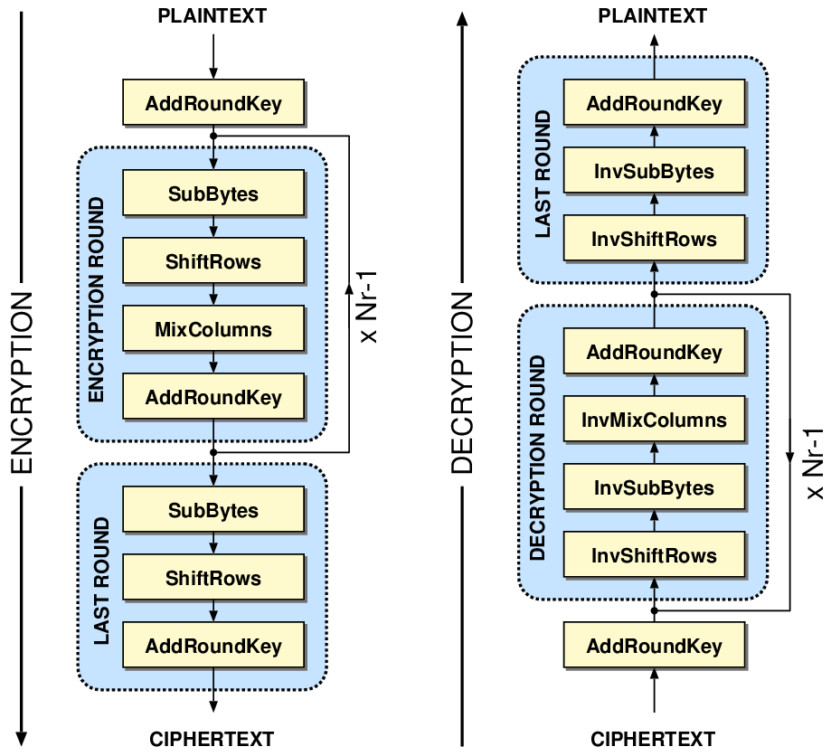
AES in big picture
AES-128
10 rounds
AES-192
12 rounds
AES-256
14 rounds

Slide 5
Block Ciphers and …
Padding
Modes of Operation
Initialization Vector (IV)
Message Integrity Code (MIC)
Message Authentication Code (MAC)

Slide 6
Byte Padding
ANSI X.923
... | DD DD DD DD DD DD DD DD | DD DD DD DD 00 00 00 04 |
... | DD DD DD DD DD DD DD DD | DD DD DD DD DD DD DD 01 |
PKCS#7 (RFC 5652)
... | DD DD DD DD DD DD DD DD | DD DD DD DD 04 04 04 04 |
... | DD DD DD DD DD DD DD DD | DD DD DD DD DD DD DD 01 |
ISO/IEC 7816-4
... | DD DD DD DD DD DD DD DD | DD DD DD DD 80 00 00 00 |
... | DD DD DD DD DD DD DD DD | DD DD DD DD DD DD DD 80 |
Zero padding
... | DD DD DD DD DD DD DD DD | DD DD DD DD 00 00 00 00 |
... | DD DD DD DD DD DD DD DD | DD DD DD DD DD DD DD 00 |

Slide 7
What if data blocks are …
Case #1
... | DD DD DD DD DD DD DD DD | DD DD DD DD DD DD DD DD |
Case #2
... | DD DD DD DD DD DD DD DD | DD DD DD DD DD DD 04 04 |
... | DD DD DD DD DD DD DD DD | DD DD DD DD DD DD DD 01 |
... | DD DD DD DD DD DD DD DD | 00 00 00 00 00 00 00 00 |

Slide 8
Modes of Operation
Electronic codebook (ECB)
Cipher-block chaining (CBC)
Cipher feedback (CFB)
Output feedback (OFB)
Counter (CTR)

Slide 9
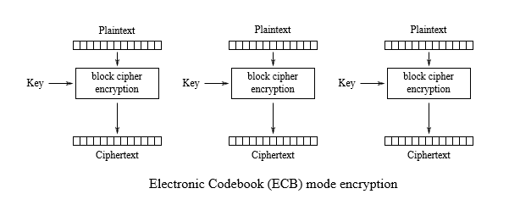
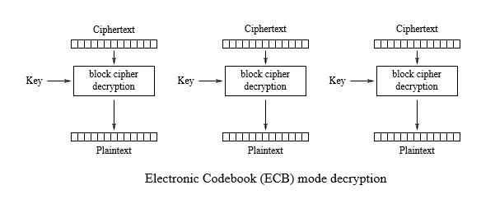
Electronic codebook (ECB)

Slide 10
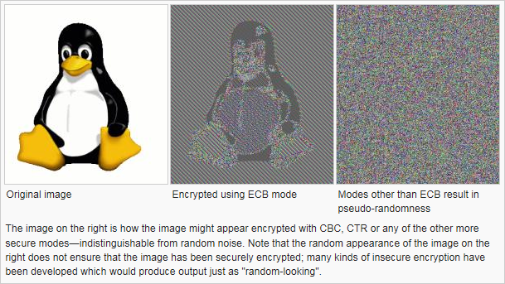
Say ‘NO’ to ECB!

Slide 11
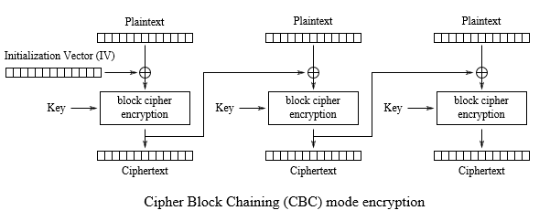
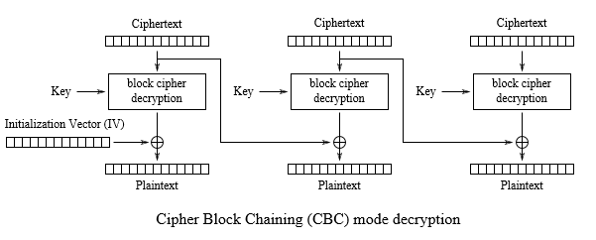
Cipher-block chaining (CBC)

Slide 12
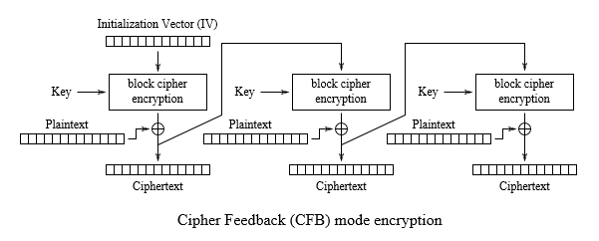
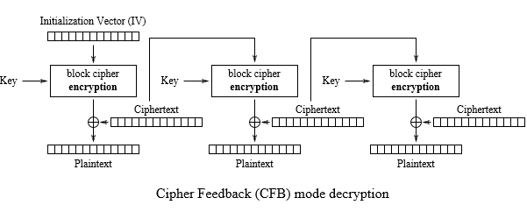
Cipher feedback (CFB)

Slide 13
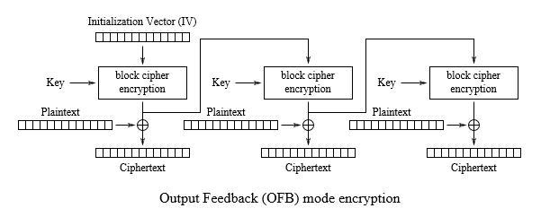
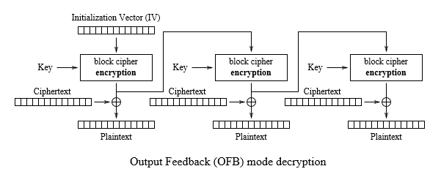
Output feedback (OFB)

Slide 14
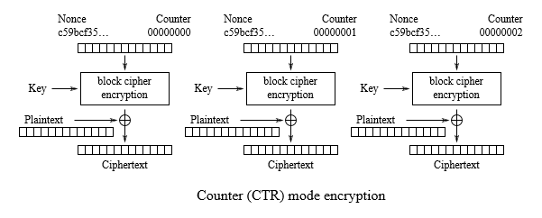

Counter (CTR)

Slide 15
Initialization Vector (IV)
Random Block
Lack of any pattern
Be sent along with Ciphertext blocks
Random Number Generator (RNG)
True Random (Physical Methods)
Noise
Entropy
Pseudo Random (Computational Methods)
PRNG
Seed

Slide 16
IV-like
Cryptographic nonce
Arbitrary number used only once in a cryptographic communication to prevent the Replay Attacks
Salt
Short additional data for one-way function to defend against the Dictionary Attacks and the Pre-computed Table Attacks

Slide 17
When confidentiality is not enough!

Slide 18
Message Integrity Code (MIC)
MIC = H(m); H() is cryptographic hash function which is
Infeasible to generate a message that has a given hash (Pre-image Resistance; One-Way)
Infeasible to modify a message without changing the hash (Second pre-image Resistance; Strong Avalanche)
Infeasible to find two different messages with the same hash. (Strong Collision Resistance)

Slide 19
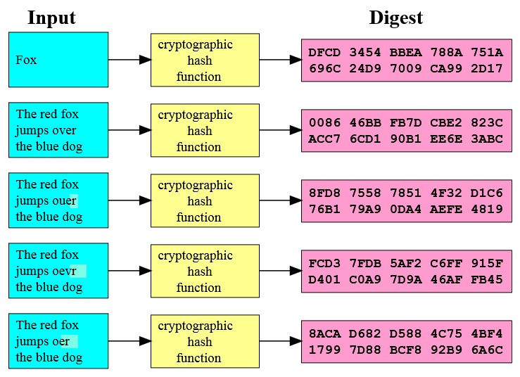
Cryptographic hash functions
SHA-1
160-bit MIC
SHA-256
256-bit MIC
SHA3-512
512-bit MIC
MIC ~ Digest
MIC ~ MD

Slide 20
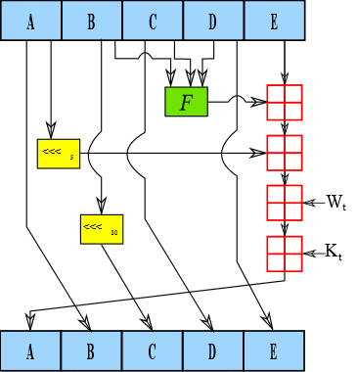
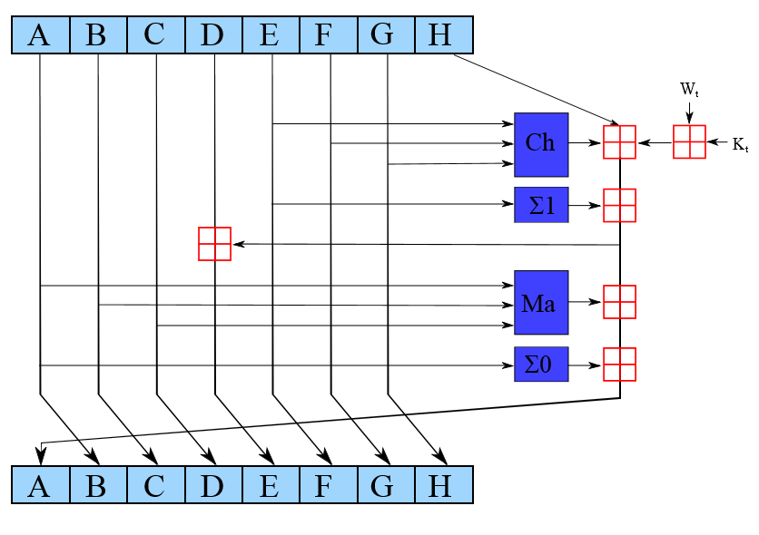
SHA-1 vs SHA2
W_{t} = message word of round t
K_{t} = constant of round t

Slide 21
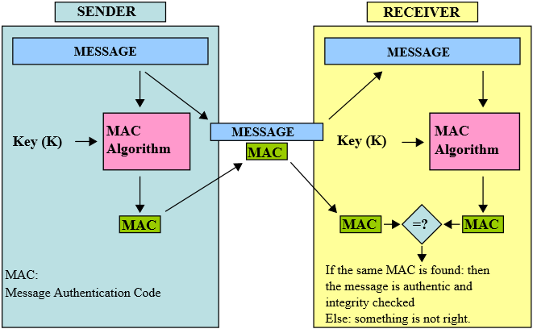
Message Authentication Code (MAC)
MAC = H(m,K); K is the MIC guardian

Slide 22
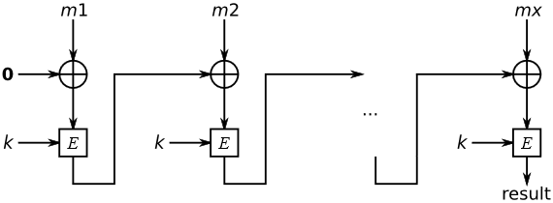
MAC functions
HMAC(K,m)
H((K ⊕ opad)|H((K ⊕ ipad)|m))
CMAC or CBC-MAC

Slide 23
つづく

